Slide 1

Basic Details of the Team and Problem Statement
Organization: National Council of Educational Research and Training (NCERT), Department of School Education & Literacy (DoSEL)
PS Code: KH1155
Problem Statement Title: To Maintain and Enjoy Healthy Relationships with Others
Team Name: Out of Box Thinkers
Team Leader Name: Aneerban Chowdhury
Institute Code (AISHE): C-41513
Institute Name: D.Y. Patil College of Engineering, Pune
Theme Name: Miscellaneous

Slide 2

Team Member Details
Team Leader Name: Aneerban Chowdhury
Branch: Bachelor of Engineering (BE) Stream: Computer Engineering Year: IV
Team Member 1 Name: Sakshi Nasha
Branch: Bachelor of Engineering (BE) Stream: Computer Engineering Year: IV
Team Member 2 Name: Megha Pal
Branch: Bachelor of Engineering (BE) Stream: Computer Engineering Year: IV
Team Member 3 Name: Kushal Therokar
Branch: Bachelor of Engineering (BE) Stream: Computer Engineering Year: IV
Team Member 4 Name: Aman Kumar
Branch: Bachelor of Engineering (BE) Stream: Computer Engineering Year: IV
Team Member 5 Name: Arnav Gupta
Branch: Bachelor of Engineering (BE) Stream: Information Technology Year: IV

Slide 3
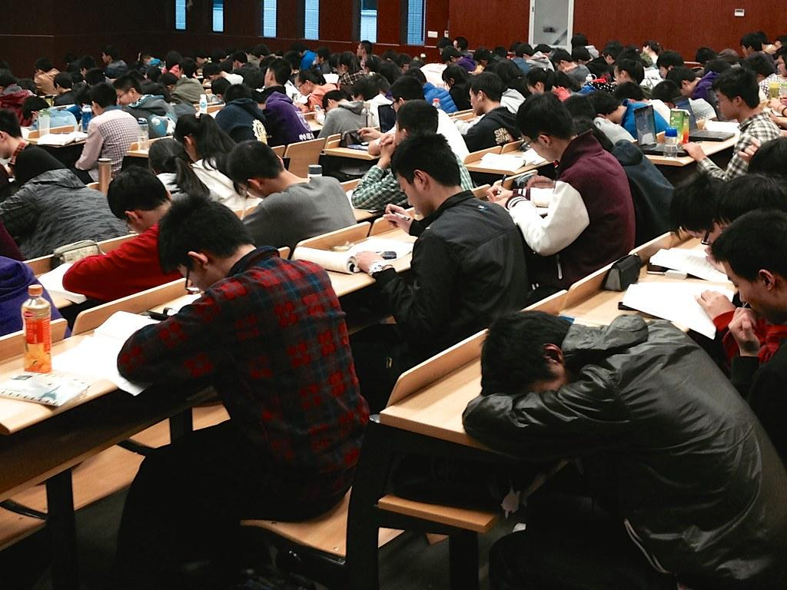

The main mantra to maintain healthy and nurturing relationships is effective communication.

Slide 4
Approach Details
We hardly pay heed to our non-verbal skills and are unaware of our voice, facial expressions, hand gestures, eye contact & speech rate while communicating with others
To cater this, we have come up with a solution that provides an interface to the user (school or college student) to record his/her answers in textual or audio-video formats to the situational questions asked as per their age group
Based on these answers we extract various features & perform facial emotion analysis, hand gesture analysis, speech rate analysis, eye movement analysis and calculation of loudness & pitch of voice.
The predicted results (in textual and graphical format will not only help us to understand our communication and interpersonal skills but also will help to improve trust, empathy, healthy relationships and conflict resolution with each other.

Slide 5
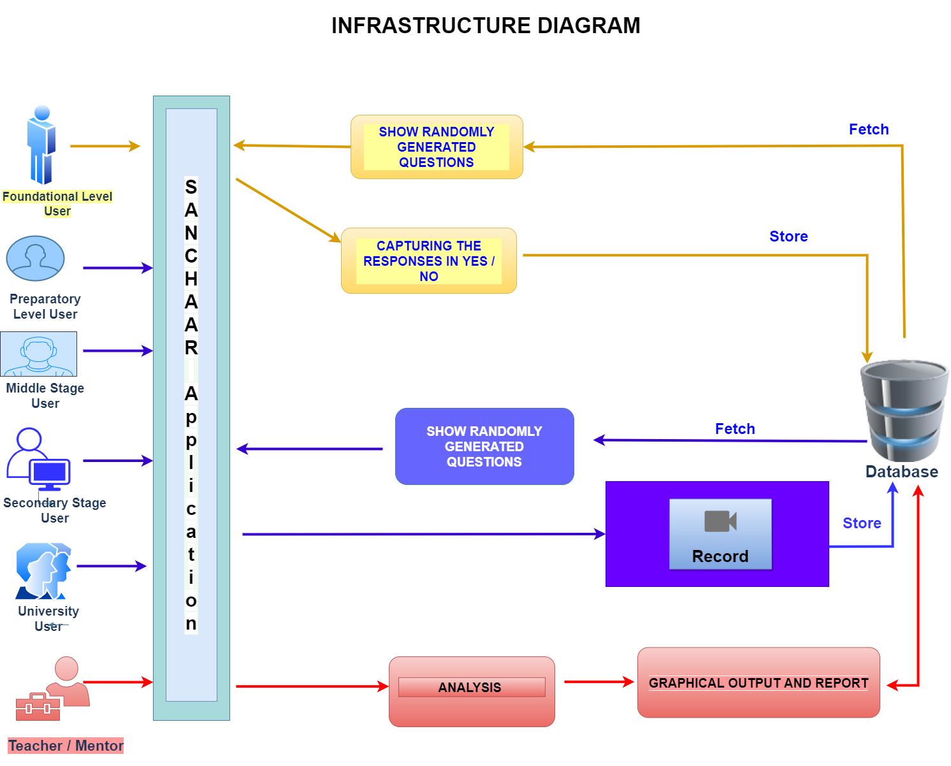

Slide 6
Technology Stack
1. ML Modules - Python
Facial Emotion Analysis - Haar Cascade Classifier
Speech Rate Analysis - Google Voice
Pitch & Loudness Calculation - Scipy Library
Eye Gaze Analysis - Using DLib Library
Hand Movement Analysis - Keras & Tensorflow
Text to Emotion - NLTK, text2emotion
2. User Interface - Python (Tkinter)
3. Python Libraries:
Numpy, Pandas, Matplotlib, Tensorflow, Keras, Scipy, Threading, PyAudio, SpeechRecognition, OpenCV, Tkinter
4. Database:
Structured Query Language (SQL), DynamoDB (Cloud based Structured database)

Slide 7
Use Cases
It is used for nurturing healthy relationships and respecting each other by recognizing the facial expressions, rate of speech, eye movements and hand gestures of the students and suggesting them the appropriate action to be taken
It is also used for learning to deal with conflicts and developing empathy in students by asking them questions and recording them which are later noted down by the teacher/mentor to guide them through good decision making for resolving conflicts and developing empathy.
The speaker can practice gestures that are likely to resonate with the audience to improve the chances of making a good impression

Slide 8
Scope of our Project
Role Wise Login :
Student
Teacher / Mentor / Interviewer
Target Group (Stage Wise)
School Level
Foundational stage ( age 5-8 yrs )
Preparatory stage ( age 9-12 yrs)
Middle stage (age 13-16 yrs)
Secondary stage (age 16-19 yrs)
College / University Level
Youth (above teenager)

Slide 9
OUTPUTS FOR DESKTOP APP

Slide 10
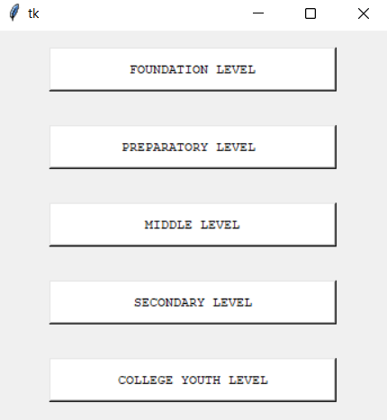
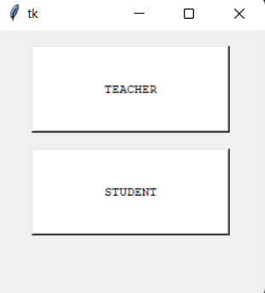
Stages of Education
Login Page

Slide 11
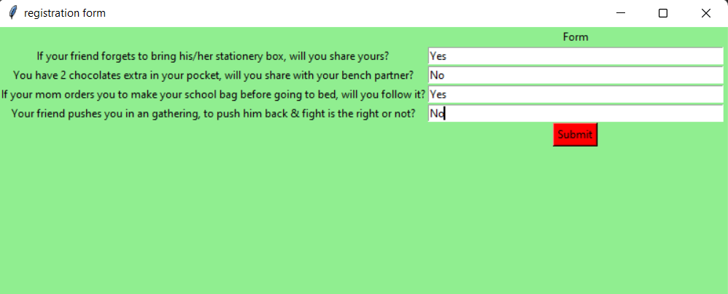
Foundational Level Questions

Slide 12
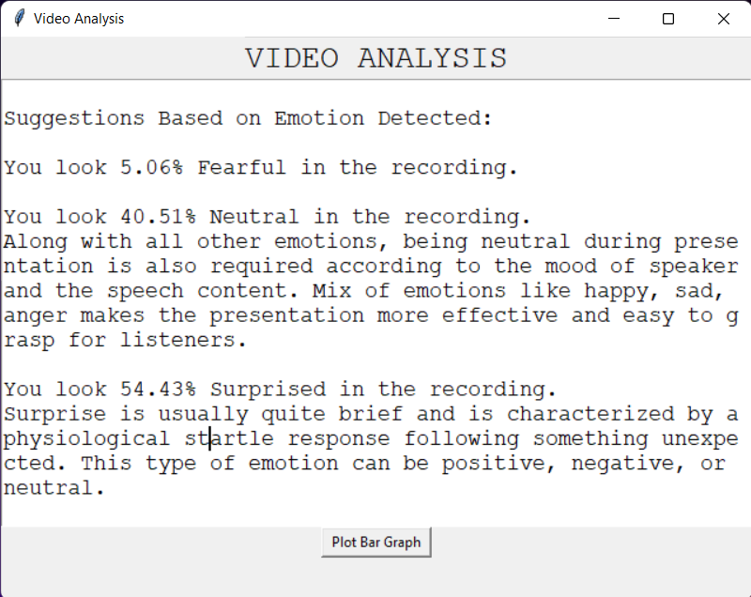

Slide 13
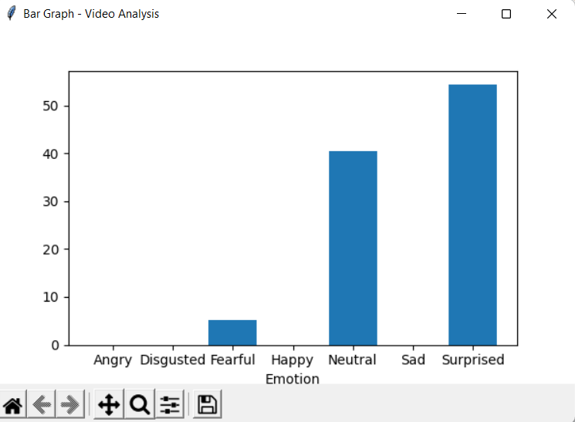

Slide 14
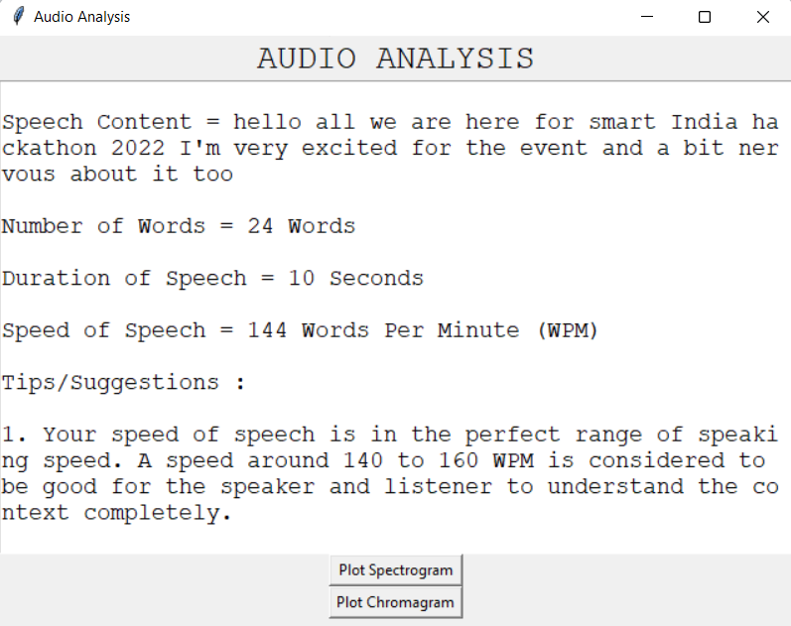

Slide 15
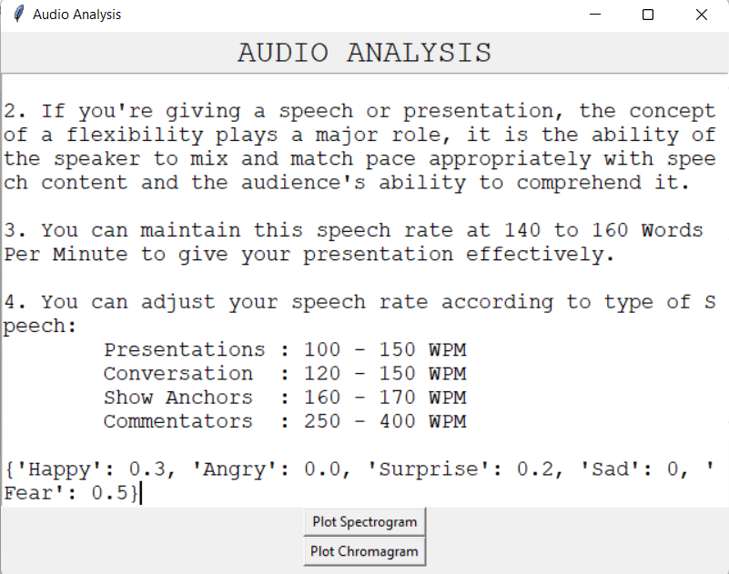

Slide 16
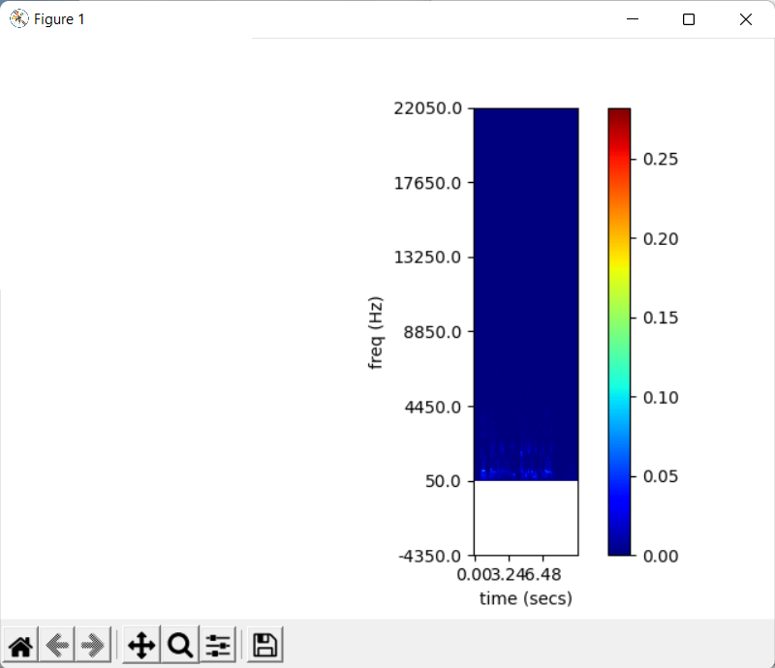

Slide 17
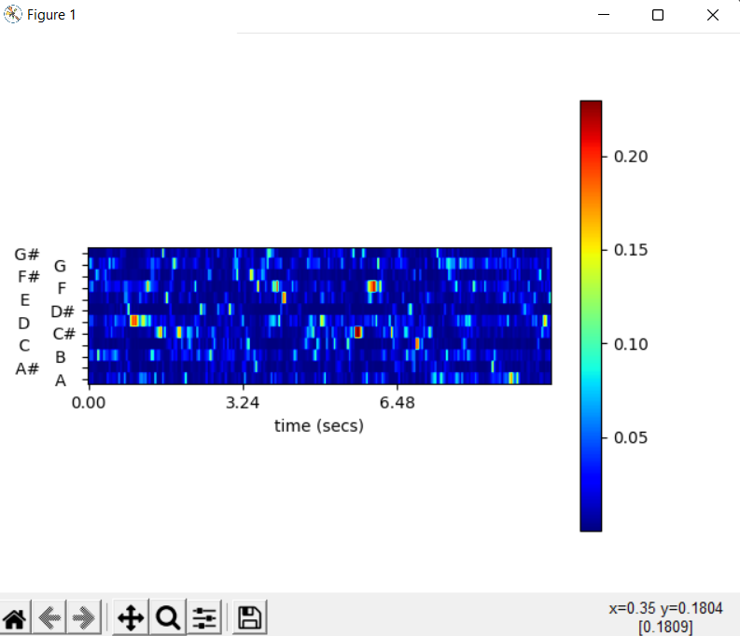

Slide 18
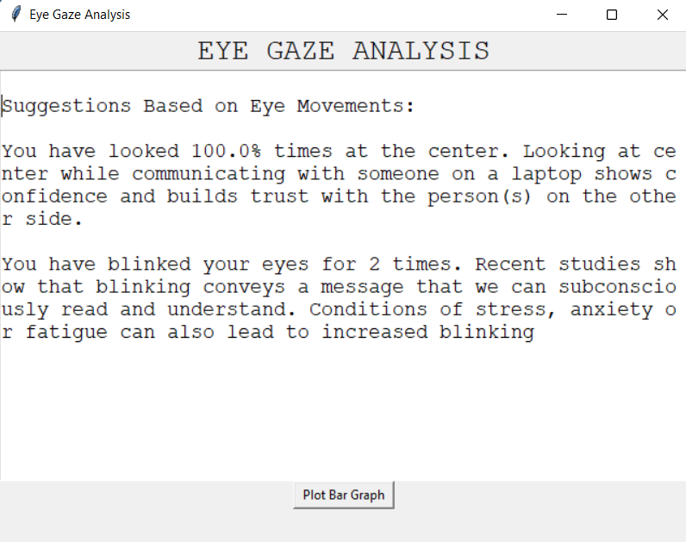

Slide 19
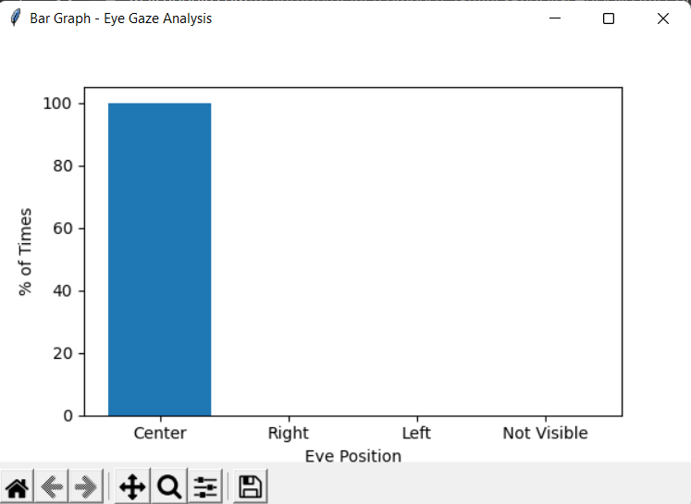

Slide 20
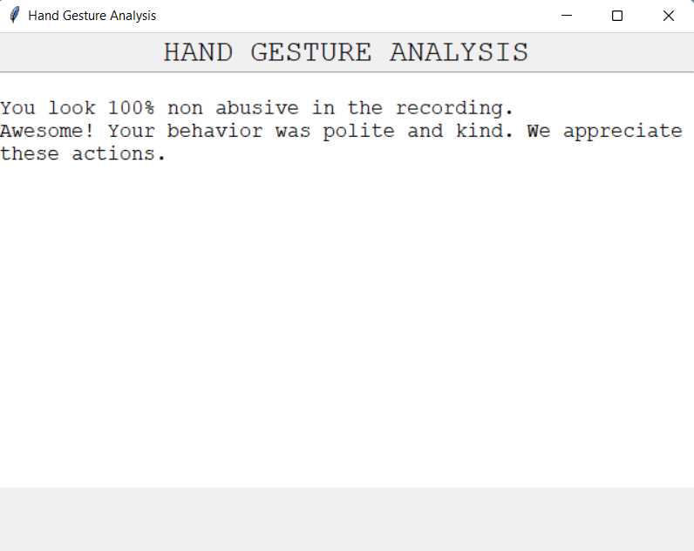

Slide 21
MOBILE APP PROTOTYPE

Slide 22
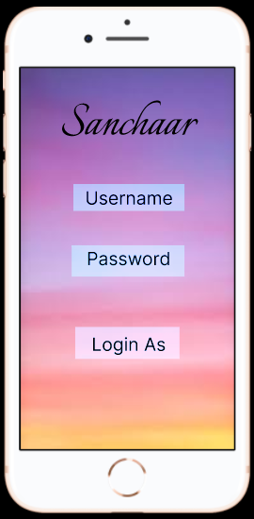
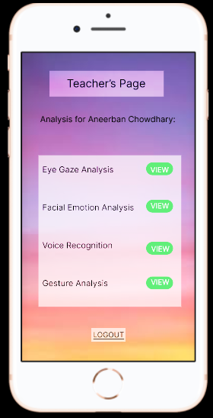
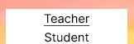

Slide 23
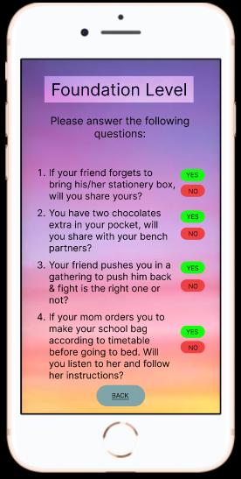
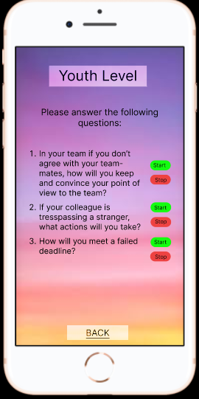

Slide 24
Outcome of our Project
Developing effective communication skills :
Our desktop application focuses on analysis on verbal and non verbal skills
Developing interpersonal skills & Enhancing self-awareness :
Our application makes the speaker aware of its own speech rate, emotions,behaviour,etc
Developing empathy (perspective taking) :
We have incorporated dataset of questions that are situational and depict the perspective and decision making ability of user
Accepting and respecting others ways to nurture positive relationships :
The responses provided by the user will help in understanding the relationship around them.
Practicing communication :
Our app can we used to practice for an interview or meetup by student or any business person.
Healthy ways of dealing with conflicts :
The situational responses provided by the user will help in understanding the relationship.
Students can build and maintain healthy and nurturing relationships with people around them :
For relationship to be healthy, we have incorporated the feature where we can identify abusive and unhealthy behaviour by monitoring user actions.

Slide 25
Business Parameters
Portability
It is a cross platform application that is built using python module “pyinstaller” which creates standalone executable file (.exe) with all libraries, dependencies bundled up together to run the application on all OS.
Interactibility
The user can easily interact with the system by answering to the asked questions. The answers can be in form of text or audio-video. The user can be prompted
Robustness
The system is able to identify and deal with corner cases like invalid inputs, face not found, eye not recognised, too far or near to the screen.
Simplicity and Easy to use
The UI has limited buttons and functionalities which proves to be simple and easy to understand for all users of the application. Our app can be used in easy manner for a new user too.
Responsiveness
The application is highly responsive to the external inputs and provides analysis with low latency and high throughput.

Slide 26
Limitations
The application basically is a Python based application. So the end user should always have Python installed.
Right now the application is focusing on only one user at a time. So, the user needs to be in a well equipped environment with no background audience and no noise disturbance.
The application doesn’t incorporate the use for physically challenged people.
The application is highly latent as the storage is hosted on a traditional ‘on prem desktop’. If we host it on Cloud then efficiency will increase.
The application is vulnerable to cyber attacks as we don’t have role based login security.

Slide 27
Future Scope
Currently our application only focuses on English Language. In future we will try to incorporate other dialects also.
Currently, the scope of our project is restricted only to normal people. Later through hand gesture recognition and audio prompting,we can interact with physically challenged people also.
In future, for longer communication we will incorporate frame wise and periodic interval analysis.
In future we will store history of data and this will be useful in comparative analysis over a period of time.
Maintenance of user profile for role based access.
Deployment and Hosting on AWS for using the application on android and desktop.

Slide 28
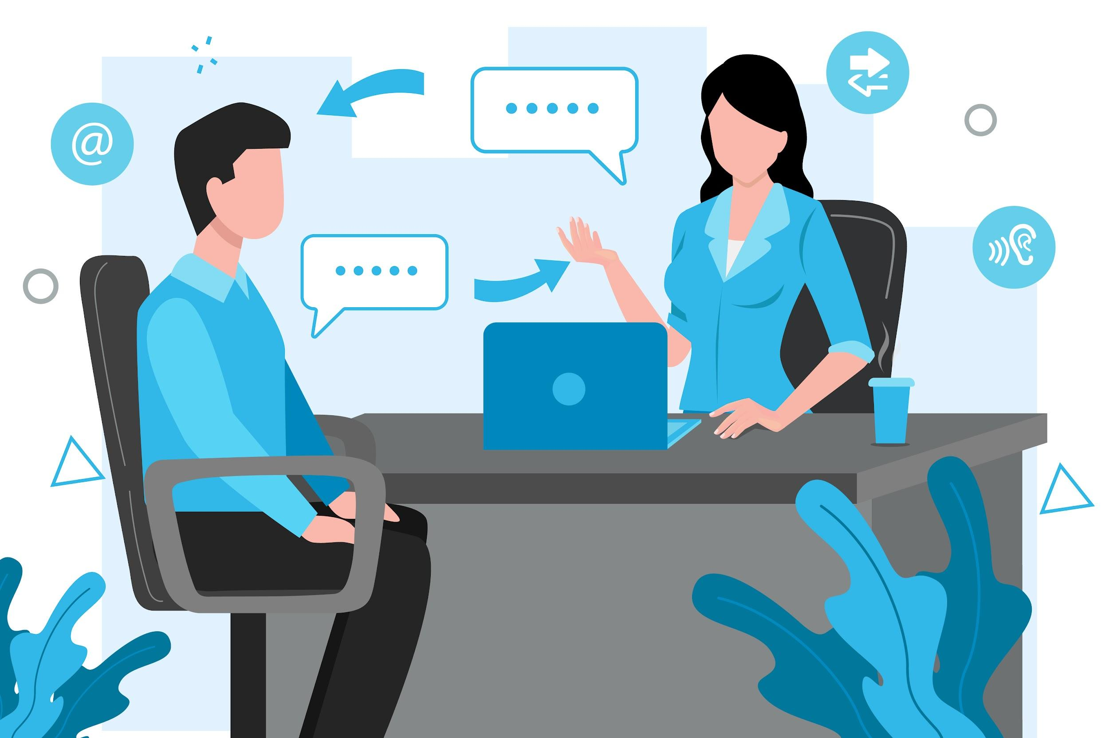
Effective communication is 20% what you know and 80% how you feel what you know.

Slide 29


